Slide 1




Flutter – Lecture 14

Slide 2
Topics to be Covered
We will Cover following in more detail :
Application Program Interface
HTTP Package
Code and Body
Fetching Data and Display

Slide 3
APIs

Slide 4

API (Application Program Interface)
An API is a set of routines, protocols, and tools for building software applications.
You must have API Keys.
Notes:
APIs are like the engine of a car. You don't have to know how it works but rather just turn the key in the ignition and it handles everything underneath. APIs are like fabric woven together from different sources to make something new.

Slide 5
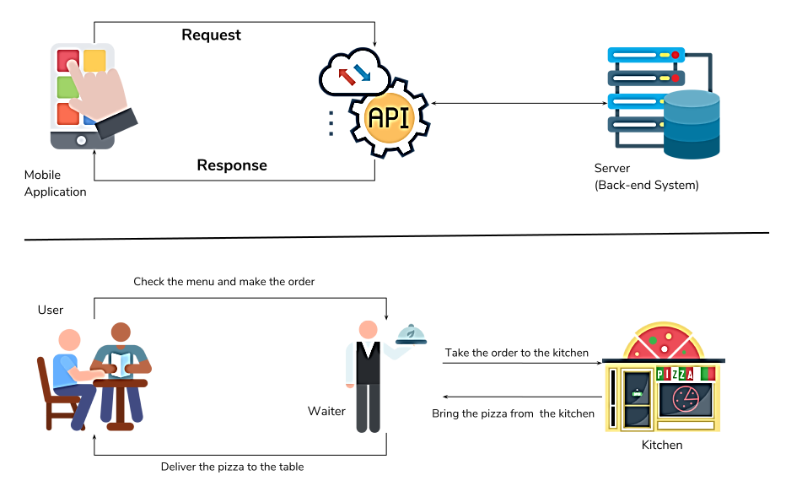
API
Notes:
Fetching data from the internet is necessary for most apps. Dart and Flutter provides http package to use http resources.
This package contains a set of high-level functions and classes that make it easy to consume HTTP resources.
The http package uses await and async features and provides many high-level methods such as read, get, post, put, head, and delete methods for sending and receiving data from remote locations.
The http package also provides a standard http client class that supports the persistent connection. This class is useful when a lot of requests to be made on a particular server. It should be closed properly using the close() method.

Slide 6
The core methods of the http package are as follows:
Read: This method is used to read or retrieve the representation of resources. I
Get: This method requests the specified url from the get method and returns a response as Future<response>.
Post: This method is used to submit the data to the specified resources.
Put: This method is utilized for update capabilities.
Head: It is similar to the Get method, but without the response body.
Delete: This method is used to remove all the specified resources.

Slide 7
API
API recipe uses the following steps:
Add the http package.
Make a network request using the http package.
Convert the response into a custom Dart object.
Fetch and display the data with Flutter.

Slide 8
Add the http package
To install the http package, add it to the dependencies section of the pubspec.yaml file. You can find the latest version of the http package the pub.dev.
dependencies:
http: ^0.13.4
Import the http package.
import 'package:http/http.dart' as http;
Additionally, in your AndroidManifest.xml file, add the Internet permission.
<uses-permission android:name="android.permission.INTERNET" />

Slide 9
Using hMake a network request
Future<http.Response> fetchWeather() async {
return await http.get(Uri.parse(' api.openweathermap.org/data/2.5/weather?q={city name}&appid={API_key}'));
}
Future is a core Dart class for working with async operations.
The http.get() method returns a Future that contains a Response.
The http.Response class contains the data received from a successful http call.

Slide 10
Getting the response code and body
Get the response body
response.body
Get the resoonse code
response.statusCode
HTTP response codes
Informational responses (100–199)
Successful responses (200–299)
Redirection messages (300–399)
Client error responses (400–499)
Server error responses (500–599)

Slide 11
Getting the response code and body
Future<Post> fetchPost() async {
final response = await http.get( Give the link of JSON file');
if (response.statusCode == 200) {
// If the server returns an OK response, then parse the JSON.
return Post.fromJson(json.decode(response.body));
} else {
// If the response was umexpected, throw an error.
throw Exception('Failed to load post');
}
}

Slide 12
Fetch the data with Flutter.
You can call the fetch method in the initState()
class _MyAppState extends State<MyApp> {
Future<Post> post;
@override
void initState() {
super.initState();
post = fetchPost();
}

Slide 13
Display Data
Finally, display the data. You can display the data by using the FutureBuilder widget. This widget can work easily with async data sources.
FutureBuilder<Post>(
future: post,
builder: (context, abc) {
if (abc.hasData) {
return Text(abc.data.title);
} else if (abc.hasError) {
return Text("${abc.error}");
}
return CircularProgressIndicator(); // By default, it show a loading spinner.
}, );

Slide 14
Summary
Today we have learned about:
Application Program Interface
Adding HTTP Package
Making Network Request
Code and Body
Fetching Data
Display Data

Slide 15
In Next Lecture:
We will Cover in more detail:
• Flutter External Resources
• (font, image, audio/video) for Application Development

